Slide 1
Review of Neural TPP
Week 1: May 30 th – Jun 6th

Slide 2
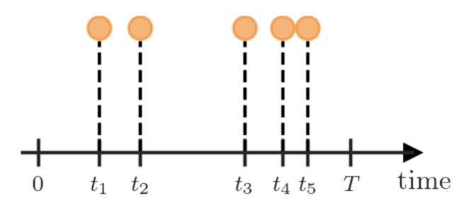
Temporal Point Process
Background:
Many real-world scenarios produce data whereby various types of asynchronous events interact with each other and exhibit complex dynamic patterns in the continuous time domain (e.g. earthquakes in a region; customer purchases over time, etc.)
Investigating this dynamic process and the underlying causal relationship will lay the foundation for further applications such as micro and macro level event prediction, root cause diagnose.
TPP:
probabilistic model used to describe sequences of discrete events that happen irregularly over continuous time. （a set of vectors {x_1,...,x_N} with both N, the number of the vectors, as well as their locations x_i are random）
We can view a TPP as an autoregressive model or as a counting process:
Temporal — we can interpret the “points” t_i as arrival times of events
Point — we can view each TPP realization as a set of “points”
Process — a TPP can be defined as a counting process
Implicit assumptions:
Events occur in continuous time:
events are modeled as occurring at specific time points t1,t2,⋯∈[0,T];
Not assumed to happen on a fixed grid;
-> Models can capture fine-grained, irregular timing.
Events are instantaneous:
Each event is a point in time — it has no duration;
No two events occur at exactly the same time (almost surely).
No simultaneous events:
P(t_i​=t_j​)=0 for i !=j [For unmarked TPPs]
model only sequences, not bulk or batch events at the same time.
the model only uses past information to predict the future

Slide 3
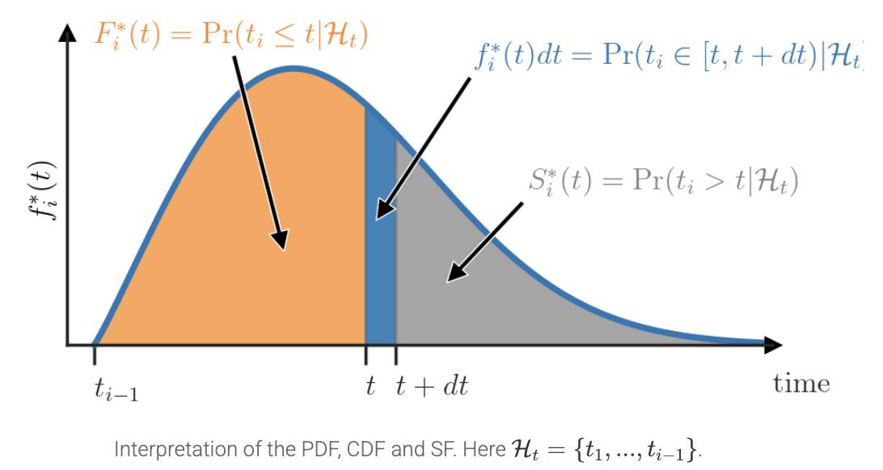
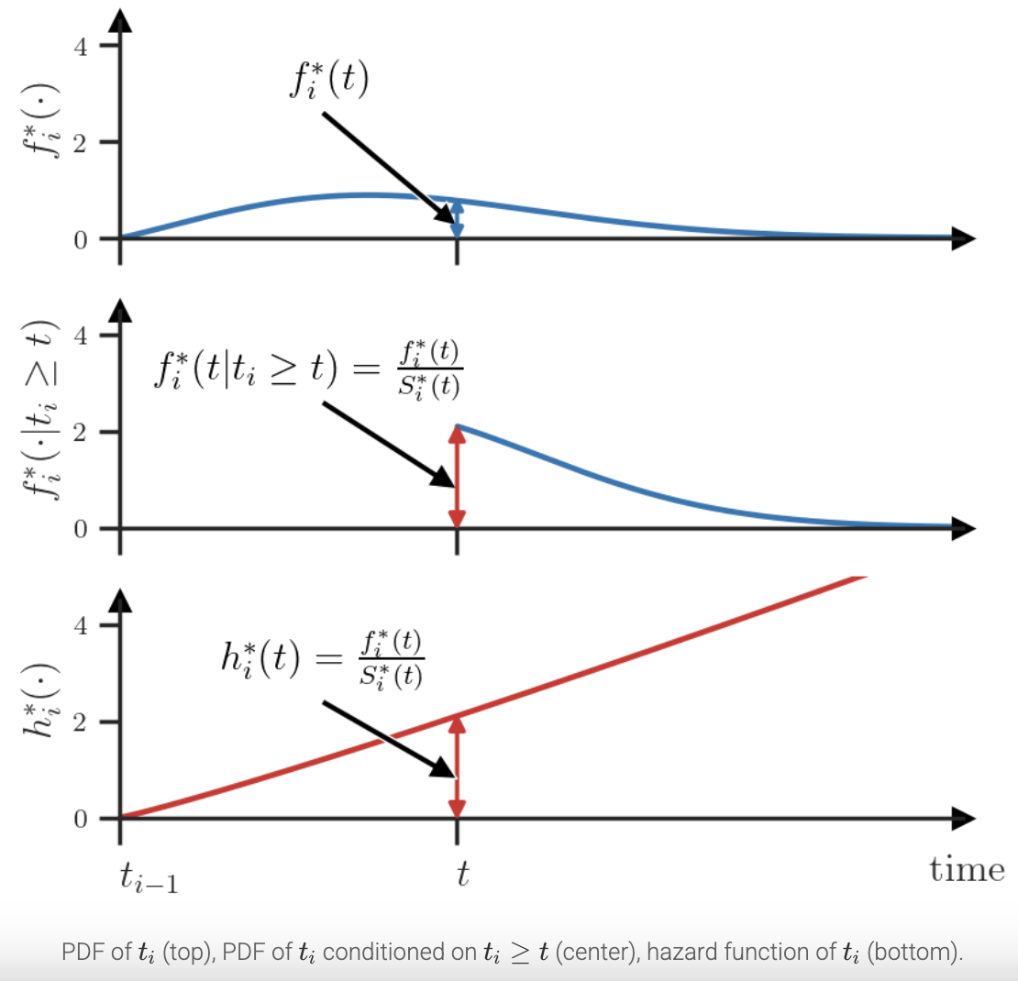
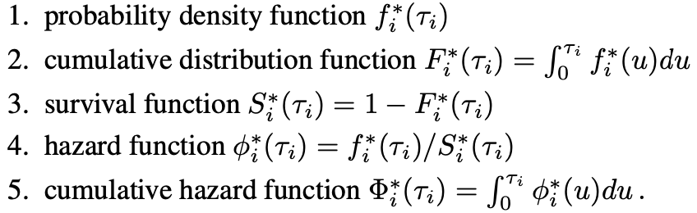
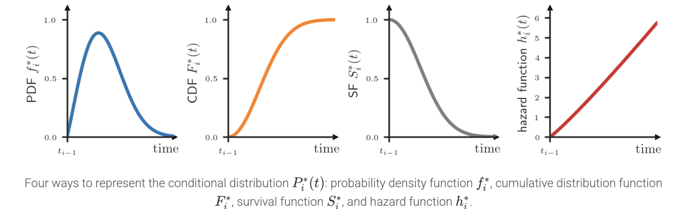
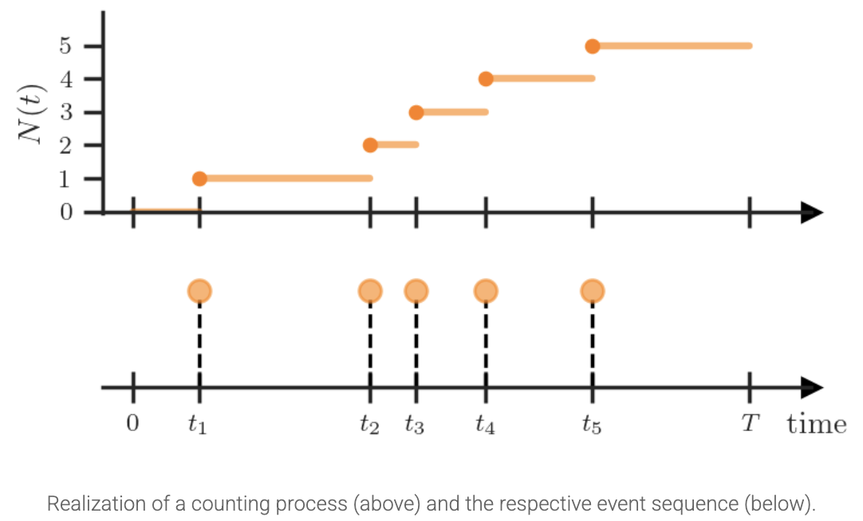
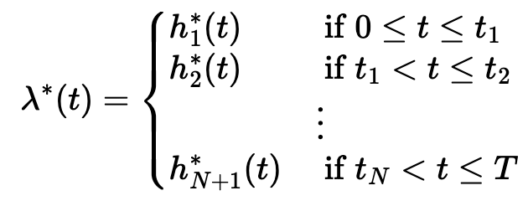

Temporal Point Process
Setting:
a probability distribution over variable-length sequences in some time interval [0, T].
A realization of a marked TPP: an event sequence X = {(t_1, m1),...,(t_N, m_N)}, where N, the number of events, 0 < t_1 < ··· < t_N ≤ T are the arrival times of events and mi ∈ M are the marks. (categorical marks help model interactions)
Either model the arrival time of the event t_i or the inter-event times τ_i =t_i −t_{i−1}, where t_0 = 0 and t_{N+1} =T
the history of past events at time t as H_t ={(t_j , m_j):t_j <t}. We usually denote this distribution as P_i(t_i|H_{t_i}), shorthand notation P_i^*(t_i);
Different ways of representing TPP (specifying one uniquely identifies the conditional distribution Pi∗):
probability density functions (PDF) f_i∗ : the value f_i^∗(t)dt represents the probability that the event t_i will happen in the interval [t,t+dt), where dt is some infinitesimal positive number.
cumulative distribution function (CDF) Fi∗: the probability that the event t_i will happen before time t.
Survival function S_i∗ : which tells us the probability that the event t_i will happen after time t.
Hazard function h_i∗: The value h_i∗(t)dt answers the question “What is the probability that the event ti will happen in the interval [t,t+dt) given that it didn’t happen before t?”.
Define TPP by conditional intensity function λ∗(t): the occurrence rate for the future event conditioned on history

Slide 4
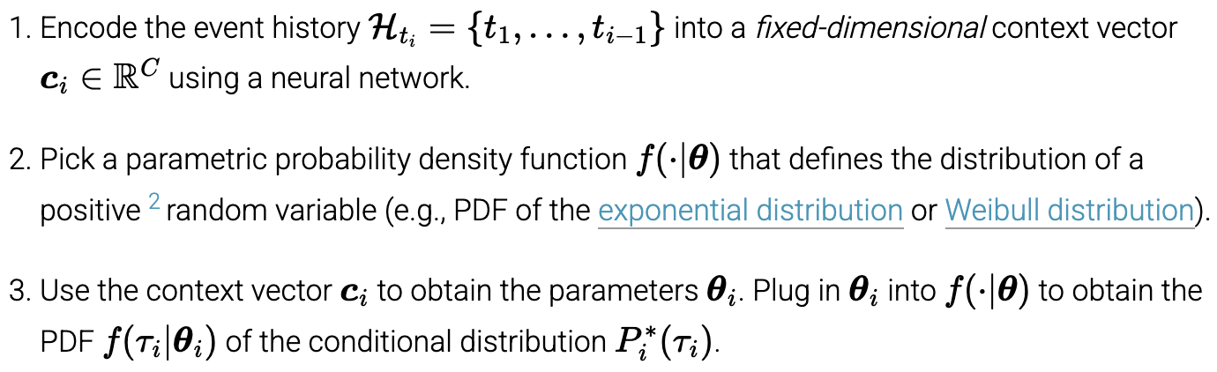
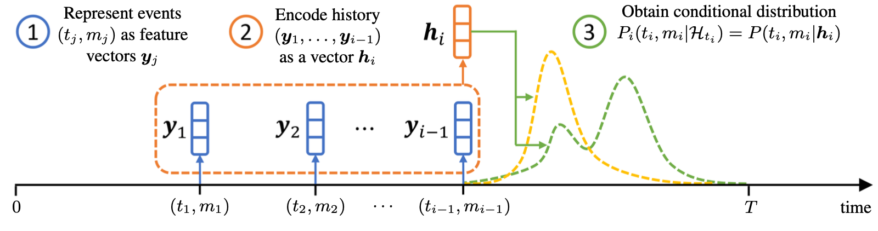
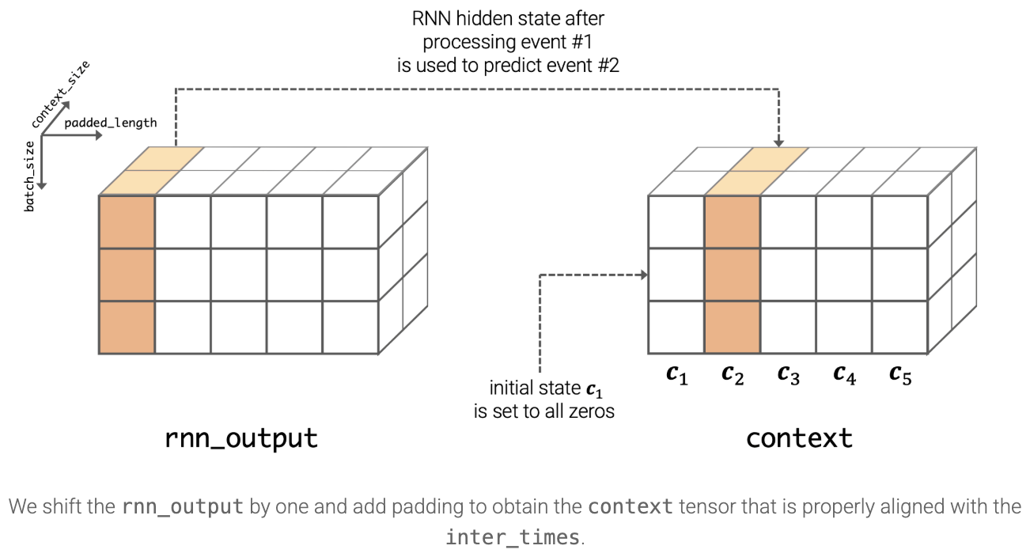
Neural Temporal Point Process
Traditional vs Neural:
traditional models either suffer from model mis-specification or the learning algorithm can be mathematically very complex for nonparametric models
Neural TPP: machine learning model that uses neural networks to model and learn when events happen in continuous time, based on event history; by learning the event dynamics from data, without requiring a fixed functional form for the intensity.
Question: How can we parametrize the conditional distribution Pi∗ with a neural network?
Core components:
History Encoder: Summarizes past events into a hidden state h(t)
Time Distribution Layer: problem of choosing a parametric distribution
make sure PDF and survival function can be computed analytically
Make sure the chosen parametrization defines a valid probability distribution
Metrics for choosing:
Flexibility (Does the given parametrization of Pi∗(τi) allow us to approximate any distribution? multi-modal one);
Closed-form likelihood (Can we compute either the CDF Fi∗, SF Si∗ or CHF Φ∗i analytically? involved in the log-likelihood, be computed in closed form for efficient model training);
Closed-form sampling (Can we draw samples from Pi∗ (τi ) analytically? In the best case, this should be done with inversion sampling)

Slide 5
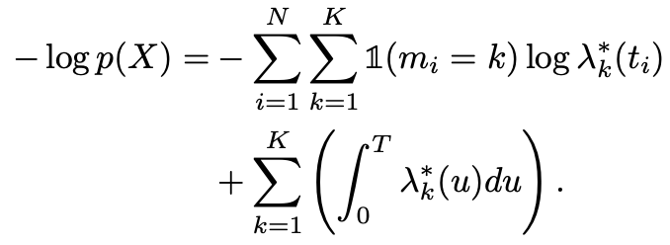
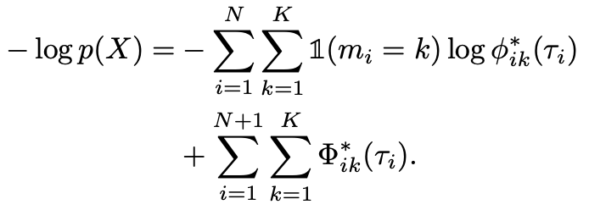
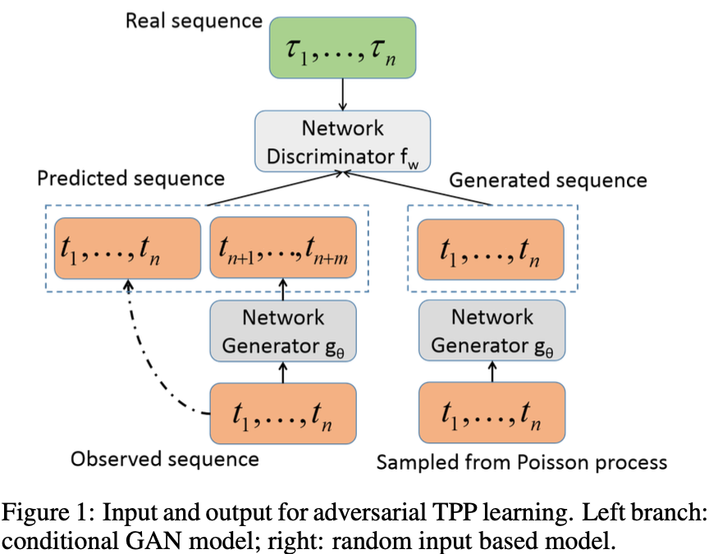
Neural Temporal Point Process
Modeling the marks
Continuous vs Discrete: whether model evolve or update the state at any moment or at between events
Training objective:
MLE: negative log likelihood (use hazard function instead of intensity function if integral would be challenging)
Likelihood Free learning:
Minimize KL divergence (sensitive to noise and outliers especially given multi-modal distributions)
Generative Adversarial Network (GAN): e.g. Wasserstein GAN, W-distance is more sensitive to the underlying
geometry structure of samples and robust to issues like mode dropping in case of multi-modal distribution
Application:
Prediction tasks:
goal is to predict the time and / or type of future events;
Applied Domain: Recommender systems; human mobility
Structure discovery:
the tasks is to learn dependencies between different event types.
Applied domain:
latent network discovery: infer influence matrix;
Granger causality: [Note: Not true causality: Correlation + time precedence ≠ intervention-based causation. Misses hidden confounders: Can be misleading if latent variables affect both X and Y. Assumes stationarity and linearity (unless extended).]

Slide 6
Neural Temporal Point Process
Open Questions:
Experimental setup:
Multiple Components of Neural TPP often change all at once making hard to pinpoint the source of empirical gains (i.e. which one contributes to the effect)
the choice of baselines varies greatly across papers: a wider range of baselines is necessary to fairly assess the strengths and weaknesses of different families of approaches.
Quality of dataset (some implicit assumptions might not suited in real-world case)
Evaluation Metrics:
NLL score:
a single NLL score obscures information regarding the model’s performance on predicting marks and times separately;
affected disproportionately by errors in marks as the number of marks increase
mostly irrelevant as a measure of error, yields little insight into model performance from a domain expert’s viewpoint.
Consider developing metrics that are based on entire sampled event sequences
Applications:
Consider more area beyond the two tasks
Narrowed in web and related domains

Slide 7
Reference
Shchur O, Türkmen A C, Januschowski T, et al. Neural temporal point processes: A review[J]. arXiv preprint arXiv:2104.03528, 2021.
Yan J. Recent advance in temporal point process: from machine learning perspective[J]. SJTU Technical Report, 2019.
Blog by Oleksandr Shchurabout
Toy Code sample

Slide 8
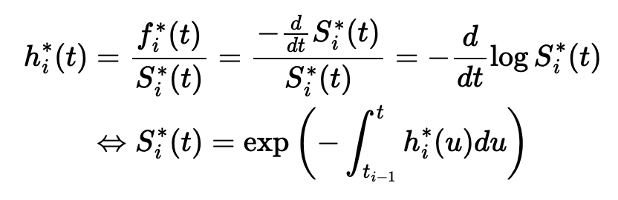
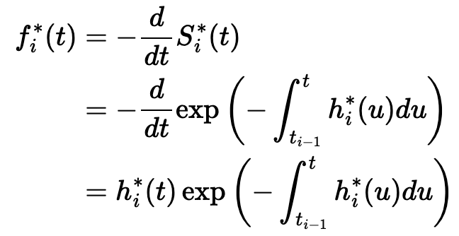
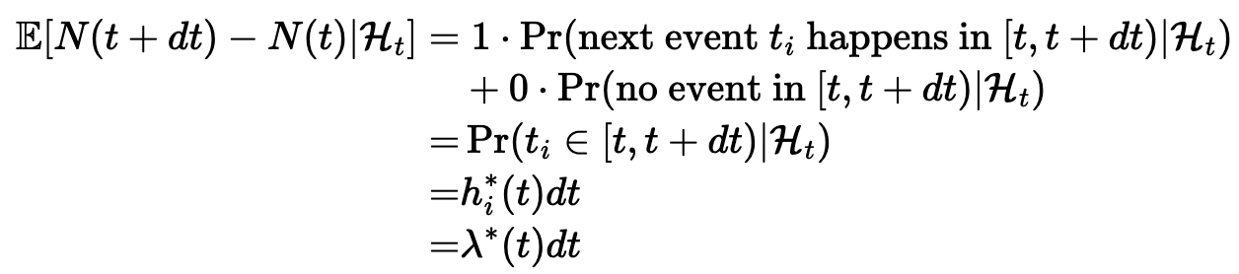
Appendix
The transformation between different formulas of TPP:

Slide 9
Central question (s)
Week 1 | Review of (Neural) TPP
Week 2 | Review of Causal TPP (challenges, current research questions investigation, open questions)
Week 3
Week 4
Week 5
Week 6
Week 7
Week 8
Week 9
Week 10

Slide 10
Thanks!

